Slide 1



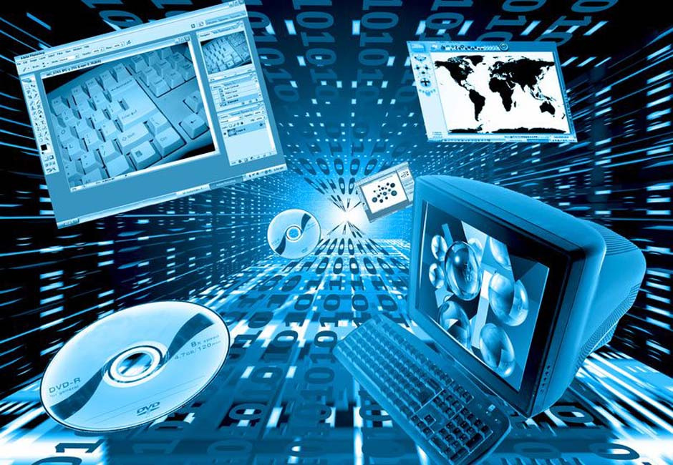
Team work № 1
Course: CSharp part 1
Team: Cloudberry
Facebook page:
Link
Telerik Software Academy
academy.telerik.com

Slide 2
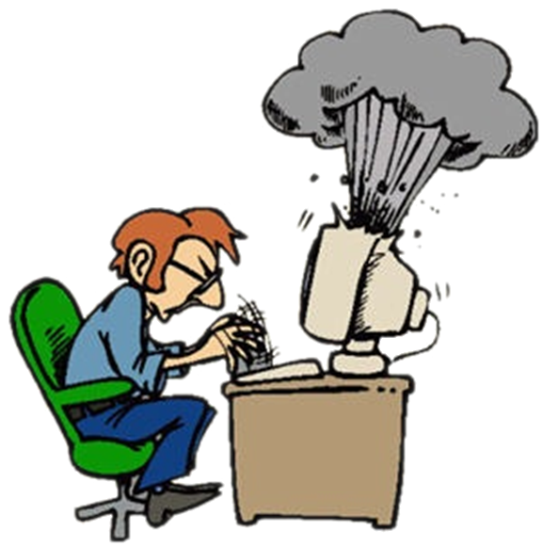

Компютърни системи
Хардуерни въпроси

Slide 3



Въпрос
Which of this interface are full duplex?
FireWire
USB2
USB3
USB3 and IEEE 1394

Slide 4

Отговор
USB3 and IEEE1394 are full duplex interface.
USB2 is interface with half duplex interface. The IEEE 1394 interface is a serial bus interface standard for high-speed communications and isochronous real-time data transfer. It was developed in the late 1980s and early 1990s by Apple, who called it FireWire. FireWire is full duplex interface
Information:
http://en.wikipedia.org/wiki/Usb

Slide 5



Софтуерни системи
Компютърен софтуер

Slide 6


Въпрос
Which of the following sentences is not a kind of compilator?
native
cross
single-pass
dev-c++
multi-pass

Slide 7

Отговор
Bloodshed Dev C++
IDE for C/C+, that use the compilator mingw, which comes from GCC (GNU Compiler Collection)
Dev-C++ can use other compilators that are based on GCC, for example Cygwin
Information:
bg.wikipedia.org/wiki/Dev-C++

Slide 8


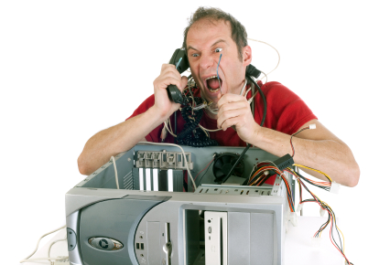
Работа с компютърни системи и програми
Инсталиране, използване, поддръжка, …

Slide 9
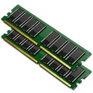
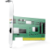


Въпрос
What is not checked in POST test?
RAM
Boot sector
LAN карта
Клавиатура

Slide 10

Отговор
Power-on self-test (POST) is a process performed by firmware or software routines immediately after many digital electronic devices are powered on. Perhaps the most widely known usage pertains to computing devices (personal computers, PDAs, networking devices such as routers, switches, intrusion detection systems and other monitoring devices). POST doesn’t check LAN cards.
Information:
http://en.wikipedia.org/wiki/Power-on_self-test

Slide 11

Пренос на данни и бройни системи
Канали за пренос на данни, единици за измерване, работа с бройни системи

Slide 12
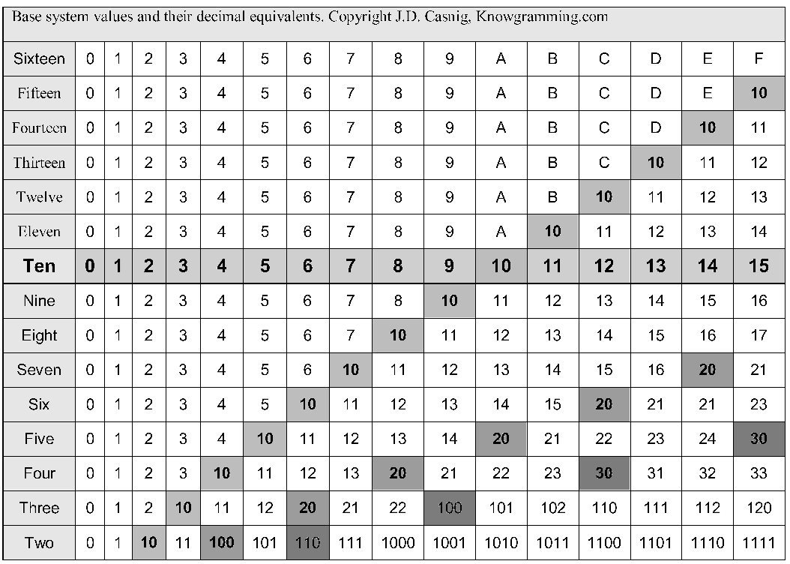
Въпрос
What is the ‘X’ base of the numeral system if it is known that (47)10= (21)x :
20
21
23
24

Slide 13
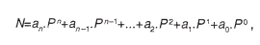
Отговор
To calculate X we can use the expression:
where P is the Base of the Numerical System ( and X in this case).
(21) x = 2 * x + 1, i.e., 47 = 2 * x + 1 => x = 23
Information : http://web.orbitel.bg/tradeschool/documents/informatics/1.3.pdf
http://bg.wikipedia.org/wiki/Бройна_система

Slide 14





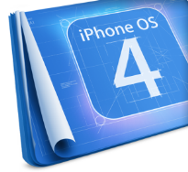









Операционни системи
Архитектура, процеси, потребители, потребителски интерфейс, файлови системи

Slide 15

Въпрос
You have on your computer Windows and Linux (Knoppix, Ubuntu)on separate partitions. The Windows partition is formatted as NTFS and the Linux – ext3. With which operation system we can read the data from the other partition without using additional software? Most standard Linux distros like Knoppix, Ubuntu have installed NTFS-3G driver which adds read support for NTFS partition.
Windows
Linux
Both
Neither of them

Slide 16


Отговор
Most standard Linux distros like Knoppix, Ubuntu have installed NTFS-3G driver which adds read support for NTFS partition.
Information:
http:/www.techspot.com/community/topics/does-linux-support-ntfs.6502/

Slide 17
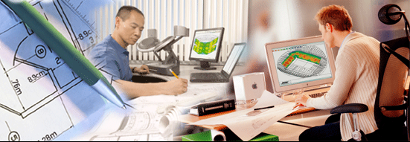
Софтуерно инженерство
Анализ, спецификация, проектиране, прототип, имплементация, тестване, поддръжка, …

Slide 18



Въпрос
With which of the following signs we can redirect the console input to a file?
->
>
>>
<-
<
<<

Slide 19
Отговор
Those operators redirect command input and output streams from the default locations to different locations. The “<” operator redirects the input stream to a file instead to the keyboard.
Information:
http://technet.microsoft.com/en-us/library/bb490982.aspx

Slide 20




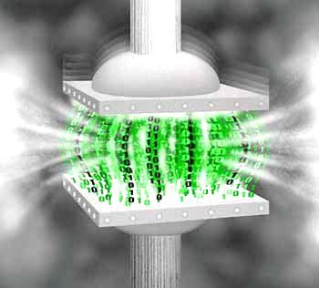




Компресиране на данни
Алгоритми за компресия, софтуер за архивиране

Slide 21
Въпрос
Huffman method of backup text files is based on:
text messages are often found several consecutive identical bits
Text messages have a significant surplus
text messages allow compression with loss of information
in the plain text of the frequency of use of the various symbols is different

Slide 22
Отговор
Huffman's algorithm, also known as Huffman coding is another technology for lossless compression. The basic idea of ​​it is that the most common symbols in the sequence must be recorded with the smallest number of bits. Thus, the algorithm builds new "alphabet" which uses this principle. Encoding is reversible. In the encoding sequence can be decompressed, i.e. may find the initial sequence of symbols.
Information:
http://www.computers.bg/teoriq_na_kompresiqta.html

Slide 23



Текстообработка
Работа с текстотобработващ софтуер, файлови формати, кодирания, текст, таблици, фигури, …

Slide 24

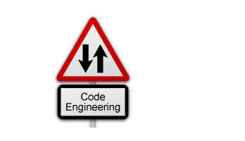
Въпрос
Which format is necessary to use “reverse code engineering”?
DOCX
PDF
ODT
PDF и ODT

Slide 25
Отговор
DOCX is an extension of Word.
All software products of Microsoft are published with incomplete specifications. That’s lead as a consequences for the others developers to use the so-called. "Reverse code engineering", in order to achieve compatibility with them when converting to the proper format.
Information:
http://www.computerworld.com/s/article/65532/Reverse_Engineering

Slide 26
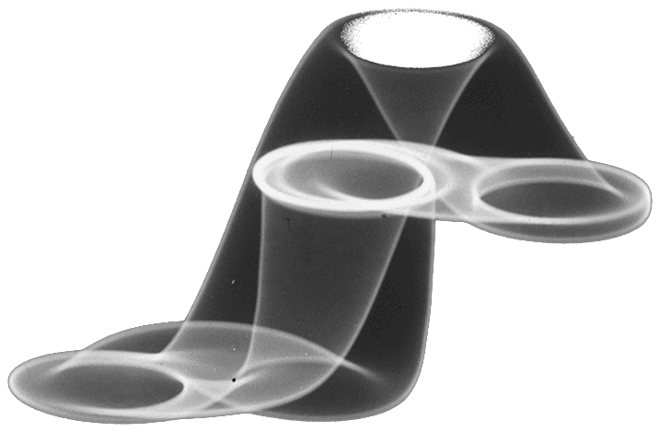



Компютърна графика
Растерна и векторна графика, графични файлови формати, графични редактори, цветови гами

Slide 27

Въпрос
Exporting is a function of graphical editors, allowing them to:
distort and animate images
transform their own format to another
read file formats other than their own
retain transparent areas in an image

Slide 28
Отговор
Example with Corel DRAW :
Select Export from File menu (File >Export) . This will bring up the export dialog box. Select the desired type of file format you wish to export as.( JPG, TIFF, BMP, EPS etc.). Provide with a path and name for the exported file
Information :
http://coreldraw.com/wikis/howto/how-to-export-from-coreldraw.aspx

Slide 29




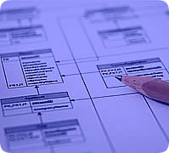

Бази от данни
Модели на данните, таблици, релации, SQL

Slide 30


Въпрос
Database system, combining two or more servers and several clients is called:
Distributed
Multifunctional
Branched
Centralized

Slide 31
Отговор
Distributed database : A database that consists of two or more data files located at different sites on a computer network. Because the database is distributed, different users can access it without interfering with one another. However, the DBMS must periodically synchronize the scattered databases to make sure that they all have consistent data
Information
http://www.webopedia.com/distributed_db

Slide 32

Информационни системи
ERP, CRM, BI, BPM, FMIS, CAD/CAM, CMS, софтуерни архитектури

Slide 33
Въпрос
The system development life cycle framework provides a sequence of activities for system designers and developers to follow. It consists of a set of steps or phases in which each phase of the SDLC uses the results of the previous one
analysis, design, development, test
design, test, analysis, development
analysis, development, test, design
development, analysis, design, test

Slide 34
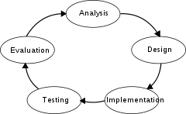
Отговор
SDLC (Systems Development Life Cycle) is a systematic methodology designed to manage the life cycle of an information system - from planning, through design, development, deployment, liquidated.
Information:
http://en.wikipedia.org/wiki/System_Development_Life_Cycle

Slide 35


Сигурност и защита на информацията
Симетрични и асиметрични кодиращи алгоритми, криптографско хеширане, електронен подпис, цифрови сертификати

Slide 36


Въпрос
How many bits is the key length of the cryptographic algorithm DES:
48
64
56
24

Slide 37


Отговор
The key ostensibly consists of 64 bits; however, only 56 of these are actually used by the algorithm. Eight bits are used solely for checking parity, and are thereafter discarded. Hence the effective key length is 56 bits, and it is always quoted as such.
Information:
http://bg.wikibooks.org/wiki/Криптография

Slide 38




Презентационни системи
Софтуер за презентации, изготвяне на презентации, слайдове, ефекти, бележки, цветове, изображения, звук, видео

Slide 39



Въпрос
Which of the following is not a presenting software?
Prezi
Google Docs
GoAnimate
DeadBeef

Slide 40


Отговор
DeadBeef is an audio player.
Information:
http://deadbeef.sourceforge.net/

Slide 41
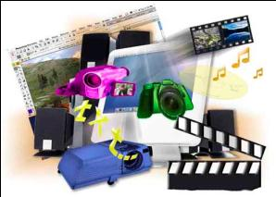

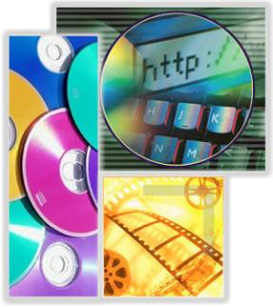

Мултимедия
Софтуер за създаване / обработка на мултимедия: звук, видео, файлови формати

Slide 42


Въпрос
Which of the following cannot open the format Indeo Video Technology (.ivf):
Windows Media Player 7
Windows Media Player 9
Windows Media Player 10
Windows Media Player 11

Slide 43
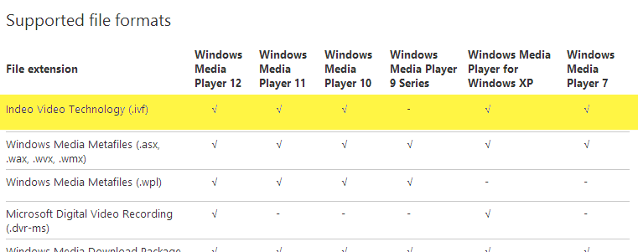
Отговор
The following table provides detailed information :
Information:
http://support.microsoft.com/kb/316992/en

Slide 44

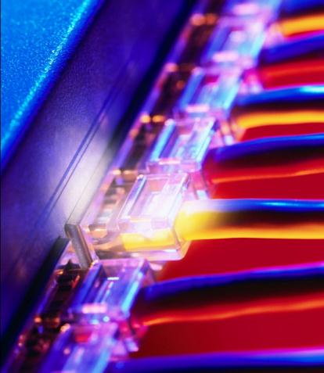
Компютърни мрежи
OSI модел, мрежови модели, протоколи, стандарти, хардуерно оборудване

Slide 45
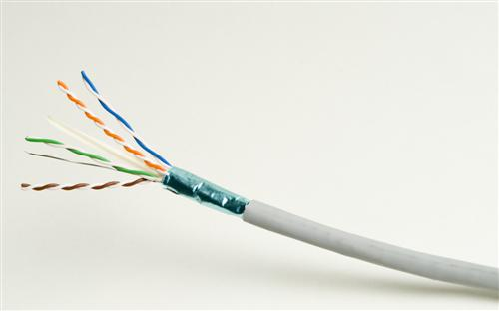
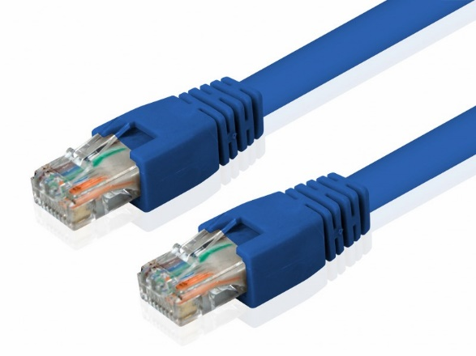
Въпрос
A LAN connects computer hardware with a wire type UTP(unshielded twisted pair), category 5 cables. How many conductors are needed for reaching 1Gbits/s transfer speed ?
2
4
6
8

Slide 46
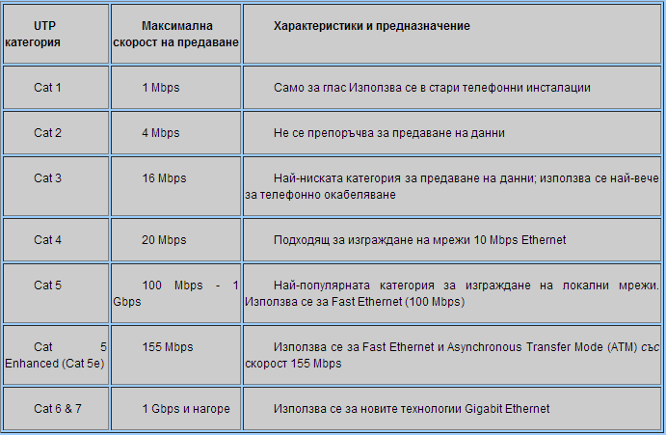
Отговор
UTP is a very popular type of LAN cable networks for several reasons: relatively inexpensive, flexible, popular uses RJ-45 connectors.
Information:
https://en.wikipedia.org/wiki/Category_5_cable
UTP cables are divided into categories based on their application and the speed of data transmission

Slide 47
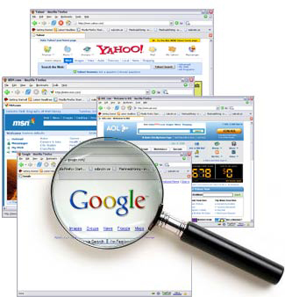


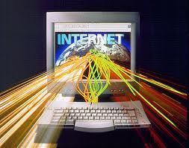
Устройство на Интернет
Интернет, протоколи, услуги, WWW, HTTP, FTP, SMTP, POP3, IMAP, WebDAV, IP, DNS, …

Slide 48
Въпрос
Which one of these protocols is not from the application layer of the OSI model:
UDP (User Datagram Protocol )
FTP(File Transfer Protocol)
RIP (Routing Information Protocol)
HTTP(Hypertext Transfer Protocol)

Slide 49
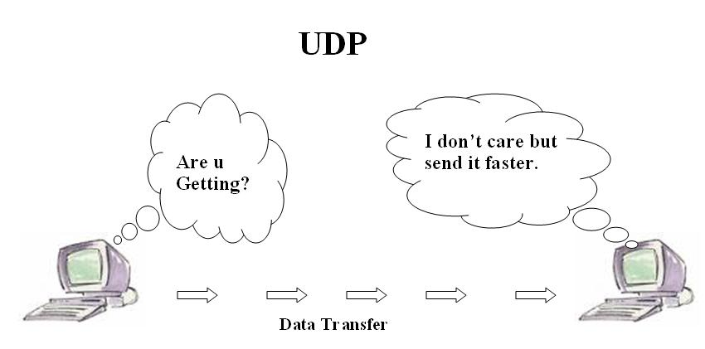
Отговор
User Datagram Protocol (UDP) is minimal transport packet protocol. In the family of TCP / IP protocols, UDP provides a simple interface between the network protocol under it and applied protocols above it.
Information:
http://bg.wikipedia.org/wiki/User_Datagram_Protocol

Slide 50





Електронна комуникация
E-mail, Skype, ICQ, IRC, MSN Messenger, Yahoo Messenger, социални мрежи, форуми, …

Slide 51



Въпрос
Skype is based on:
Client-server architecture
CO-PS communication
Peer to peer architecture
CLPS communication

Slide 52

Отговор
The system is completely decentralized peer to peer network, unlike most programs that use client-server technology
Information:
http://bg.wikipedia.org/wiki/Skype

Slide 53




World Wide Web (WWW)
Как работи WWW? Протоколът HTTP, GET, POST, URL, уеб браузър, уеб страница, уеб сайт, …

Slide 54



Въпрос
In which type of hosting, client applications do not share server resources with other applications of other users?
E-mail hosting
File hosting
Dedicated hosting
Cloud hosting

Slide 55

Отговор
Dedicated server is a service in which the client provides all hardware resources on a server. The client has a full (root) access to the server. Dedicating a server is suitable for web sites or services that have high attendance and load.
Information:
http://bg.wikipedia.org/wiki/Хостинг

Slide 56




Уеб дизайн, HTML, CSS
Уеб дизайн, HTML, CSS, текст, графика, препратки, таблици, формуляри, …

Slide 57


Въпрос
Which keywords in HTML is not associated with the creation of tables:
<table>
<form>
<td>
<tr>

Slide 58

Отговор
Tables in HTML tags are set <table> and </ table> - respectively the beginning and the end. The tables are divided into rows: <tr> and </ tr>, and each row can be divided into separate cells described by <td> and </ td>.
Information:
http://www4u.search.bg/HTML/tables.phtml

Slide 59





Скриптови езици и JavaScript
Разработка на скриптове с JavaScript, основни JavaScript конструкции, оператори, обекти, манипулация на DOM дървото

Slide 60
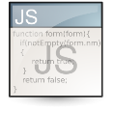
Въпрос
What are the valid ways of initialization variables in JS?
a=5; var myArray = new Array();
int a=5;var a=5;
INTEGER a ; var a=5;
byte = 6, string myArray [3];

Slide 61

Отговор
var a = 5, a = 5; var myArray = new Array(); are valid
int a = 5; byte = 6, string myArray [3]; - most strongly typed based on the C language
INTEGER a – fortran

Slide 62



Безплатни курсове в софтуерната академия
Telerik School Academy
schoolacademy.telerik.com
Telerik Software Academy
academy.telerik.com
Telerik Academy @ Facebook
facebook.com/TelerikAcademy
Telerik Software Academy Forums
forums.academy.telerik.com

